Slide 1
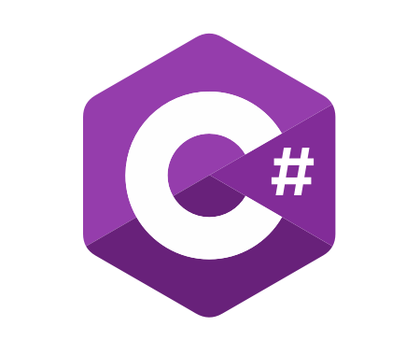
C# Advanced
Course Introduction
SoftUni Team
Technical Trainers
Software University
https://softuni.bg/

Slide 2
Table of Contents
Course Objectives
Training and Team
Course Organization
Course Infrastructure
Evaluation Criteria

Slide 3
Have a Question?
sli.do
#fund-csharp

Slide 4

Course Objectives

Slide 5
C# Fundamentals Module Goals
Working with advanced data structures
Getting familiar with streams and files
Creating custom data structures
Building class hierarchies
Apply principles and good practices for building quality software
Test application correctness

Slide 6
C# Advanced Course Goals
Working with advanced data structures
Getting familiar with streams and files
Creating custom data structures
Simple algorithms
Recursion, Sorting and Searching

Slide 7
Practical Programming Exam
3 practical problems for 4 hours
The first two problems may include:
Stacks and Queues
Multidimensional Arrays
Dictionaries
Defining Classes
Automated judge system
http://judge.softuni.bg
Solutions are evaluated for correctness only
Code quality is still not measured

Slide 8

Exam Demonstration

Slide 9

The Team

Slide 10
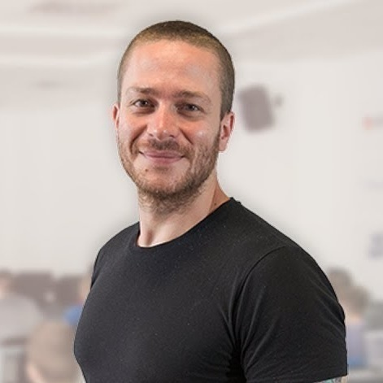
Ivaylo Kenov
Various job titles at the same time:
CTO @ SoftUni Dev Team
Technical Trainer @ SoftUni
Creator of open-source libraries for ASP.NET
MyTested.AspNetCore.Mvc
Mathematical competitions champion
Contacts:
https://github.com/ivaylokenov
https://linkedin.com/in/kenov

Slide 11
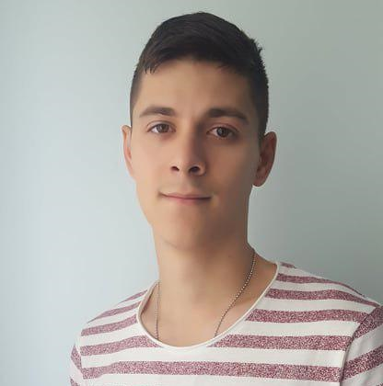
Galin Gospodinov
Technical Trainer @ Software University
Top performing student @ Software University
Interested in Web Development
Plays football in his free time

Slide 12

Course Organization

Slide 13
C# Fundamentals Module – Timeline
14-Jan-2019
24-Feb-2019
14-Apr-2019
C# Advanced
6 weeks * 4 times / week
12 credits
Start: 14-Jan-2019
Final exam: 24-Feb-2019
Retake exam: 16-Apr-2019
C# OOP
7 weeks * 4 times / week
9 credits
Start: 25-Feb-2019
Final exam: 14-Apr-2019
Retake exam: 18-Apr-2019

Slide 14

Homework Assignments & Exercises
Your homework is mainly work in class
Lesson days → slides + live demos + exercises
Exercise days → only exercises
How to submit your homework?
Submitted in the judge system
Do your homework when it's due
Assignments pile up quickly

Slide 15


Scoring System for the Course
Mandatory:
Final exam – 85%
Exercises & homework – 15%
Bonuses:
Presence in class – 5% bonus
Forum activity – bonus up to 5%

Slide 16



Course Web Site, Forum and FB Group
Official web site:
Official discussion forum:
Official Facebook group:
https://softuni.bg/courses/csharp-advanced/
softuni.bg/forum/categories/30/
https://www.fb.com/CSharpFundamentals

Slide 17


The Free C# Fundamentals Textbook
The official textbook for the course
"Fundamentals of Computer Programming with C#", by Svetlin Nakov & Co., 2013, ISBN 9789544007737
English and Bulgarian versions (as PDF, ePub, …)
Freely downloadable from: www.introprogramming.info
The C# Programming courses @SoftUni.bg partially follows the book

Slide 18
https://softuni.bg/courses/csharp-advanced

Slide 19












SoftUni Diamond Partners

Slide 20




SoftUni Organizational Partners

Slide 21




Trainings @ Software University (SoftUni)
Software University – High-Quality Education and Employment Opportunities
softuni.bg
Software University Foundation
http://softuni.foundation/
Software University @ Facebook
facebook.com/SoftwareUniversity
Software University Forums
forum.softuni.bg

Slide 22

License
This course (slides, examples, demos, videos, homework, etc.) is licensed under the "Creative Commons Attribution-NonCommercial-ShareAlike 4.0 International" license

